Slide 1
Tourism Package Report
NIRMAL KUIRY

Slide 2
Content
● Business Problem Overview
● Data Overview
● Data Preprocessing
● Exploratory Data Analysis (EDA)
● Model Performance Summary
● Business Insights and Recommendations

Slide 3
Business Problem Overview and Solution Approach
● “Elysian Adventures” is a tourism company, and the policymaker wants to enable and establish a viable business model to expand the customer base. A viable business model is a central concept that helps you understand the existing ways of doing business and how to change the ways for the benefit of the tourism sector.
● One of the ways to expand the customer base is to introduce a new offering of packages. Currently, there are 5 types of packages the company is offering - Basic, Standard, Deluxe, Super Deluxe, and King. However, it was difficult to identify the potential customers because customers were contacted at random without looking at the available information.
● The company is now planning to launch a new product i.e. Wellness Tourism Package. Wellness Tourism is defined as Travel that allows the traveler to maintain, enhance or kick-start a healthy lifestyle, and support or increase one's sense of well-being. This time company wants to harness the available data of existing and potential customers to target the right customers.
● The task is to analyze the data and build a model to predict which customer is potentially going to purchase the newly introduced travel package.

Slide 4
Data Overview
● The data contains information about 4,888 customers and their characteristics
● The characteristics include CustomerID, ProdTaken, Age, TypeofContact, CityTier, DurationOfPitch, Occupation, Gender, NumberOfPersonVisiting, NumberOfFollowups, ProductPitched, PreferredPropertyStar, MaritalStatus, NumberOfTrips, Passport, PitchSatisfactionScore, OwnCar, NumberOfChildrenVisiting, Designation, and MonthlyIncome
● 8 columns have missing values, but will keep these missing values

Slide 5
Data Preprocessing
● There are only two observations where the Duration of Pitch is greater than 37, so we will drop these rows.
● There are only four observations where the Monthly Income is greater than 40,000 and less than 12,000. Checked these observations and they seem to be the outliers.
● The percentage of categories for the Number of Trips 19 or above is very less. We can consider these values as outliers. We can see that there are just four observations with a Number of Trips 19 or greater, so we will drop these rows.
● There are missing values in a few of the numeric variables Age, Monthly income, and Number of trips, so we will impute these values with a median.
● There are missing values in a few of the categorical variables Type of contact, Preferred property star, and Number of children visiting, so we will impute these values with mode / most frequent.
● There are 6 categorical variables having string values, so we will be encoding these variables with dummies.

Slide 6
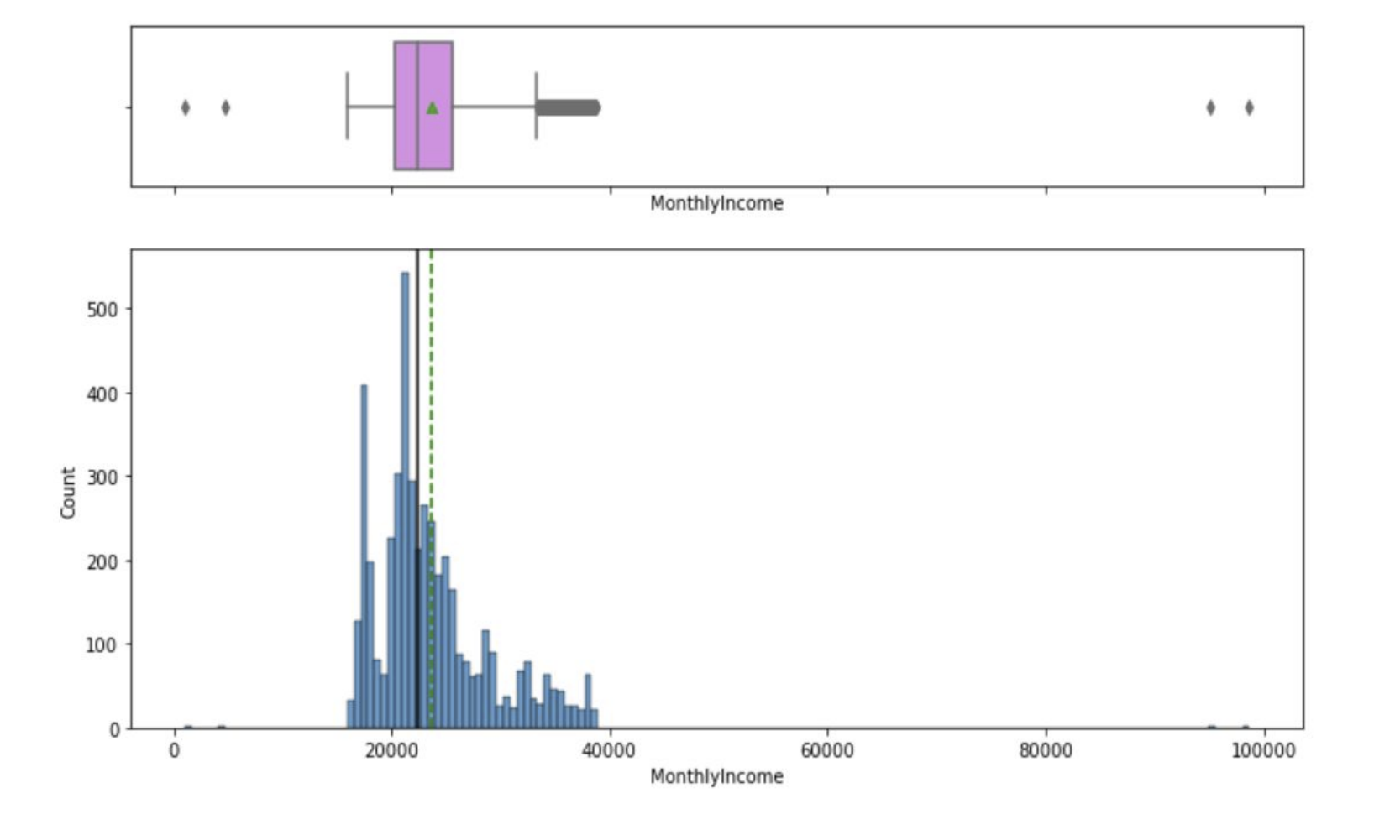
EDA Results
● The distribution for monthly income shows
that most of the values lie between
20,000 to 40,000.
● Income is one of the important factors
to consider while approaching a customer with
a certain package. We can explore this further
in bivariate analysis.
● There are some observations on the left and
some observations on the right of the boxplot
which can be considered as outliers.

Slide 7
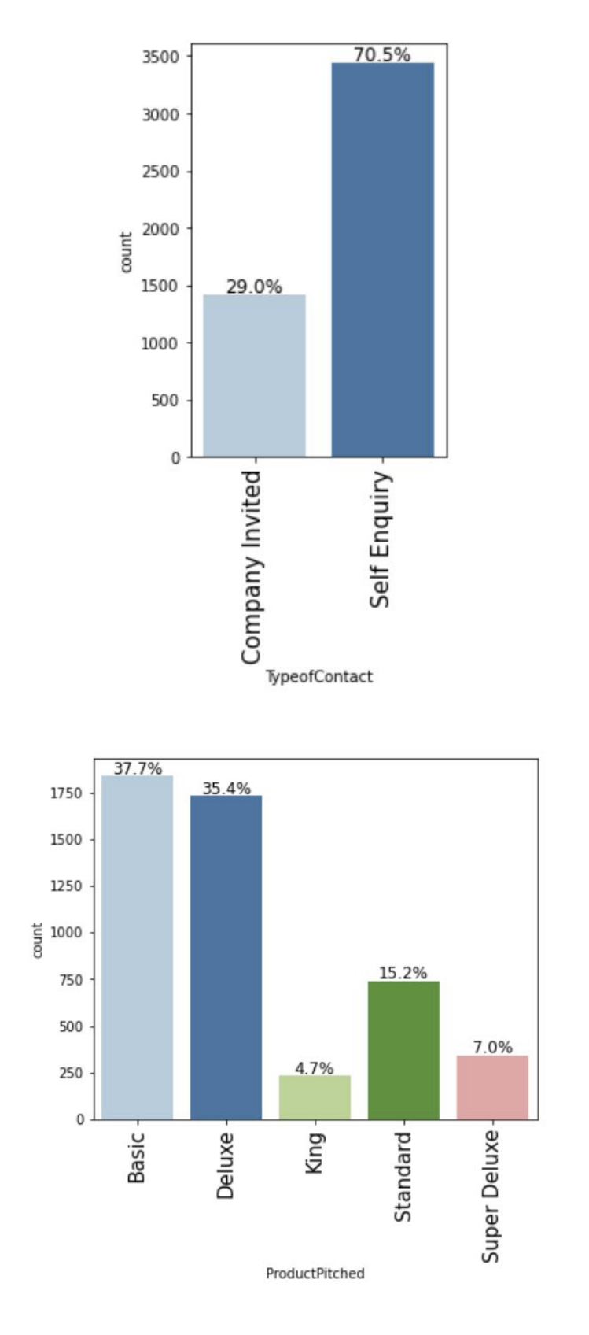
EDA Results
● There are approximately 70% of customers who reached out
to the company first i.e. self-inquiry.
● This shows the positive outreach of the company as most of
the inquiries are initiated from the customer's end.
● The company pitches Deluxe or Basic packages to their customers
more than the other packages.
● This might be because the company makes more profit from
Deluxe or Basic packages or these packages are less expensive,
so preferred by the majority of the customers.

Slide 8
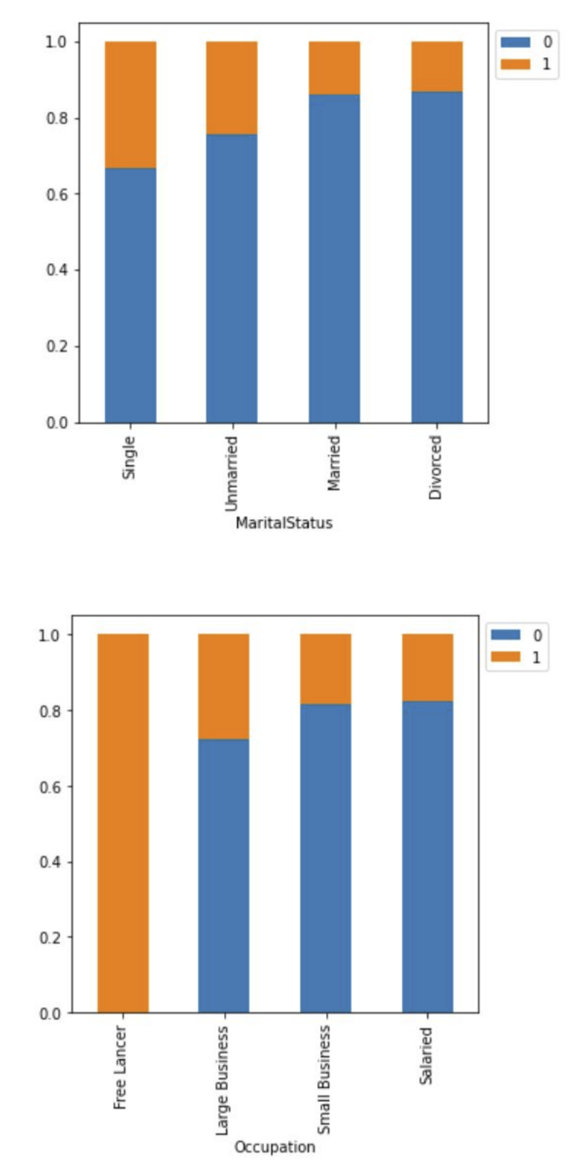
EDA Results
● We have seen that married people are the most common customer for
the company but this graph shows that the conversion rate is higher for
single and unmarried customers as compared to the married customers.
● The company can target single and unmarried customers more and can
modify packages as per these customers.
● The conversion rate for large business owners is higher than salaried
or small business owners.
● This might be because large business owners have high income.
● Freelancer have 100% conversion rate but there is just 2 such observation,
so cannot give any conclusive insights.

Slide 9
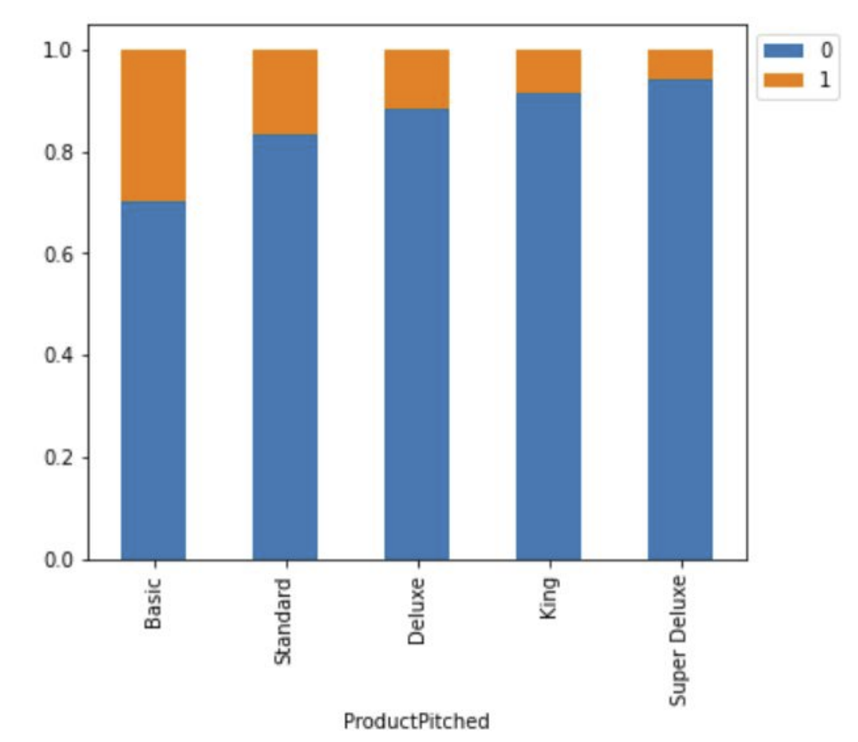
EDA Results
● The conversion rate of customers is higher if the
product pitched is Basic. This might be because the
Basic package is less expensive.
● We saw earlier that company pitches the Deluxe
package more than the Standard package, but the
standard package shows a higher conversion rate
than the Deluxe package. The company can pitch
Standard packages more often.

Slide 10
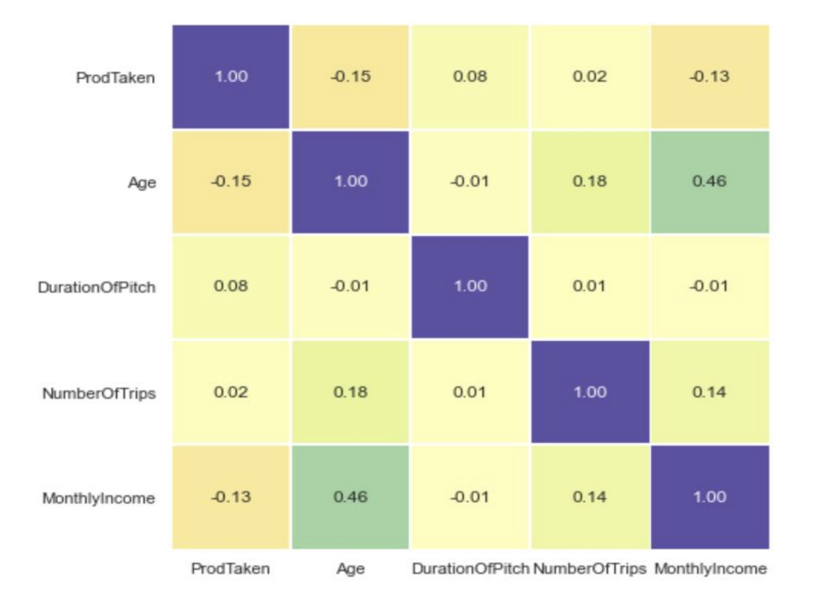
EDA Results
● The Number of trips and Age have a weak positive
correlation, which makes sense as Age increases
Number of trips is expected to increase.
● Age and Monthly Income are positively correlated.
● ProdTaken has a weak negative correlation with
age which agrees with our earlier observation that
as age increases the probability for purchasing
a package decreases.
● No other variables have a high correlation among them.

Slide 11
Model Building Steps
● Split the dataset into train, test and validation sets
● Impute missing values using mode
● Choose Model performance evaluation metric
● Build different models - Logistic Regression,DecisionTreeClassifier, RandomForestClassifier, BaggingClassifier, AdaBoostClassifier, GradientBoostingClassifier, XGBClassifier

Slide 12
Model Performance Summary
● We want to predict whether a liability customer will buy newly introduced travel package or not using the information provided to us.
● We will use Recall as the performance metric for our model because:
● Predicting a customer will buy the product and the customer doesn't buy - Loss of resources
● Predicting a customer will not buy the product and the customer buys - Loss of opportunity
● Hence, Recall is to be maximized. The greater the Recall higher the chances of minimizing false negatives.
● Tuned XGBoost model indicates the most significant predictors of buying a travel package:
○ Passport
○ Designation
○ Marital Status
○ City tier

Slide 13
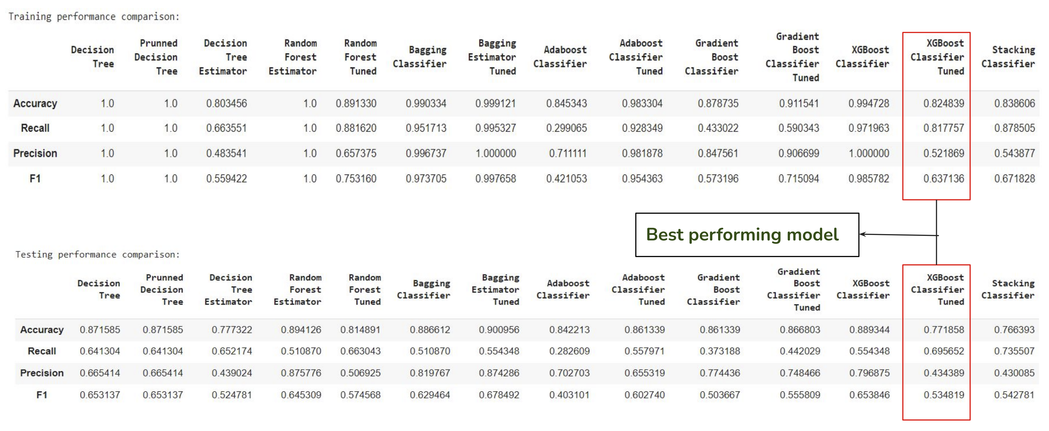
Model Performance Summary

Slide 14
Business Insights and Recommendations
● Our analysis shows that very few customers have passports and they are more likely to purchase the travel package. The company should customize more international packages to attract more such customers.
● We have customers from tier 1 and tier 3 cities but very few from tier 2 cities. The company should expand its marketing strategies to increase the number of customers from tier 2 cities.
● We saw in our analysis that people with higher income or at high positions like AVP or VP are less likely to buy the product. The company can offer short-term travel packages and customize the package for higher- income customers with added luxuries to target such customers.
● When implementing a marketing strategy, external factors, such as the number of follow-ups, time of call, should also be carefully considered as our analysis shows that the customers who have been followed up more are the ones buying the package.

Slide 15
Business Insights and Recommendations
● After we identify a potential customer, the company should pitch packages as per the customer's monthly income, for example, do not pitch king packages to a customer with low income and such packages can be pitched more to the higher-income customers.
● We saw in our analysis that young and single people are more likely to buy the offered packages. The company can offer discounts or customize the package to attract more couples, families, and customers above 30 years of age.

Slide 16
Thank you for your time!
Any questions?

